Slide 1
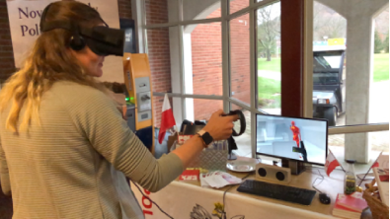
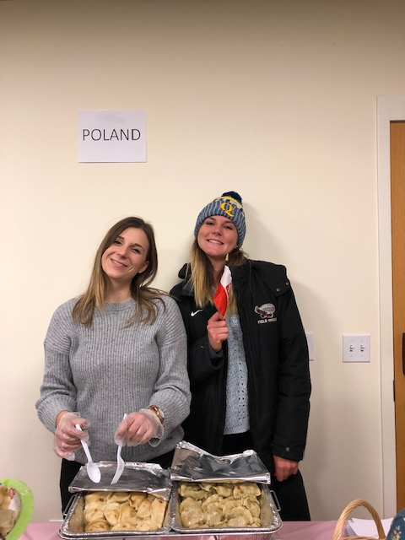

THE CENTRAL EUROPEAN INSTITUTE (CEI)

Slide 2

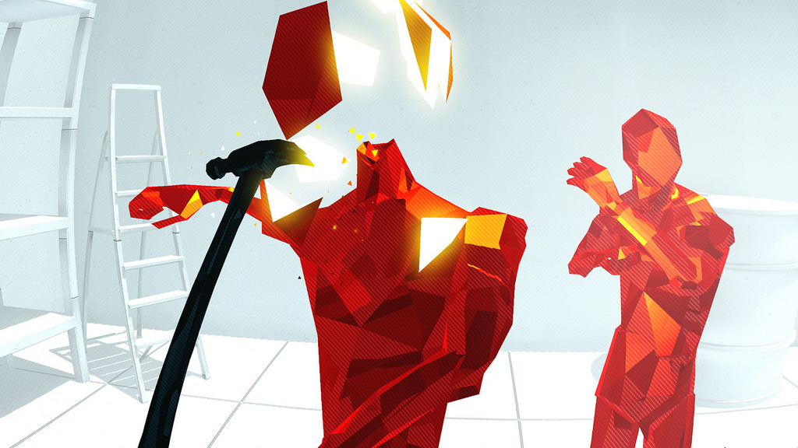
CELEBRATE 100 YEARS OF POLAND’S REGAINED INDEPENCENCE (1918 – 2018)
Polish VR game station at Quinnipiac University
November 13, 2018

Slide 3
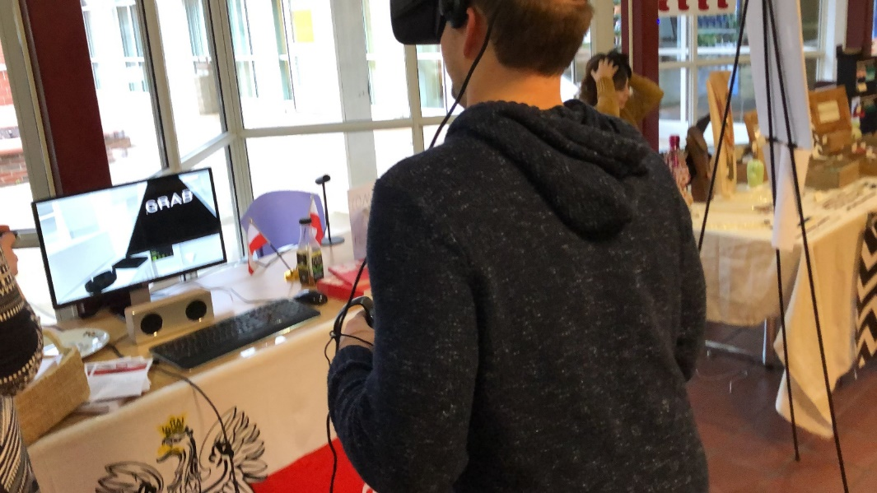
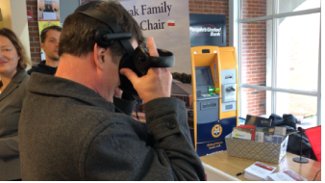
CELEBRATE 100 YEARS OF POLAND’S REGAINED INDEPENCENCE (1918 – 2018)
Everyone had a chance to try and practice Polish VR game Superhot

Slide 4
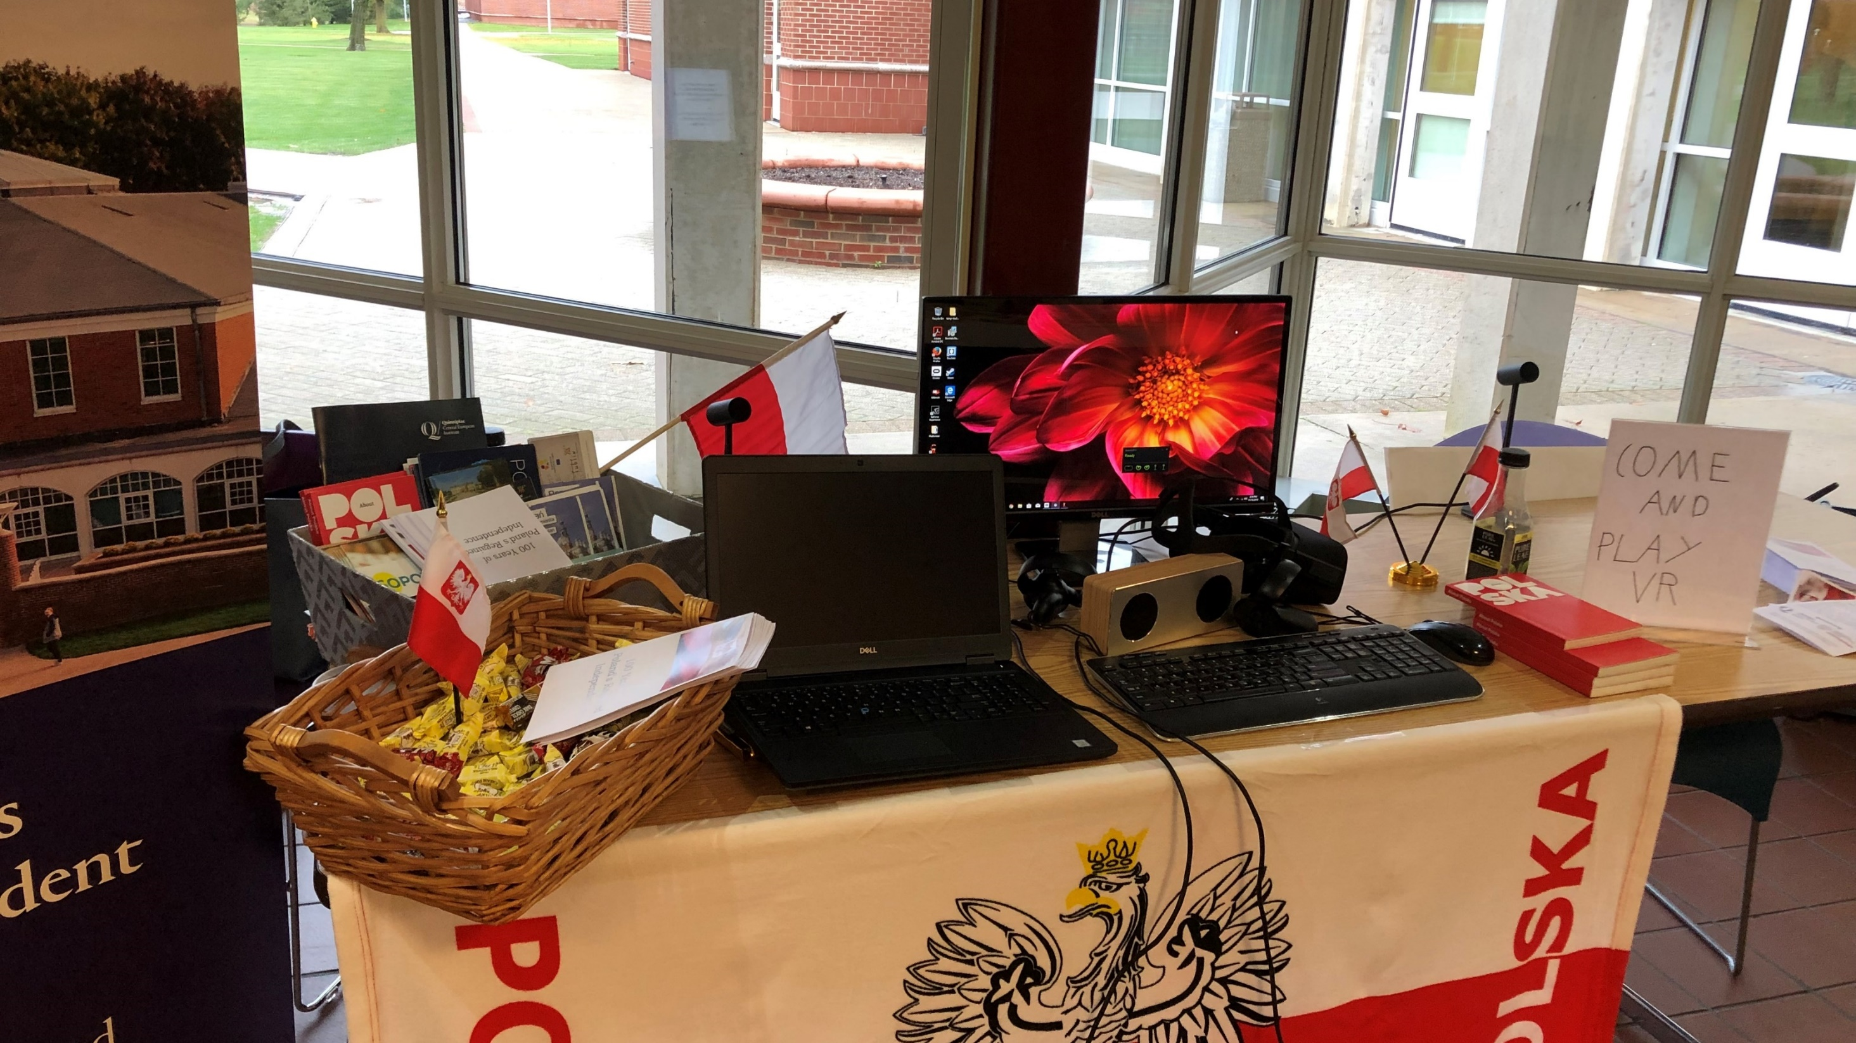
Leaflets developed by students and CEI were designed to promote Poland among Quinnipiac’s students

Slide 5
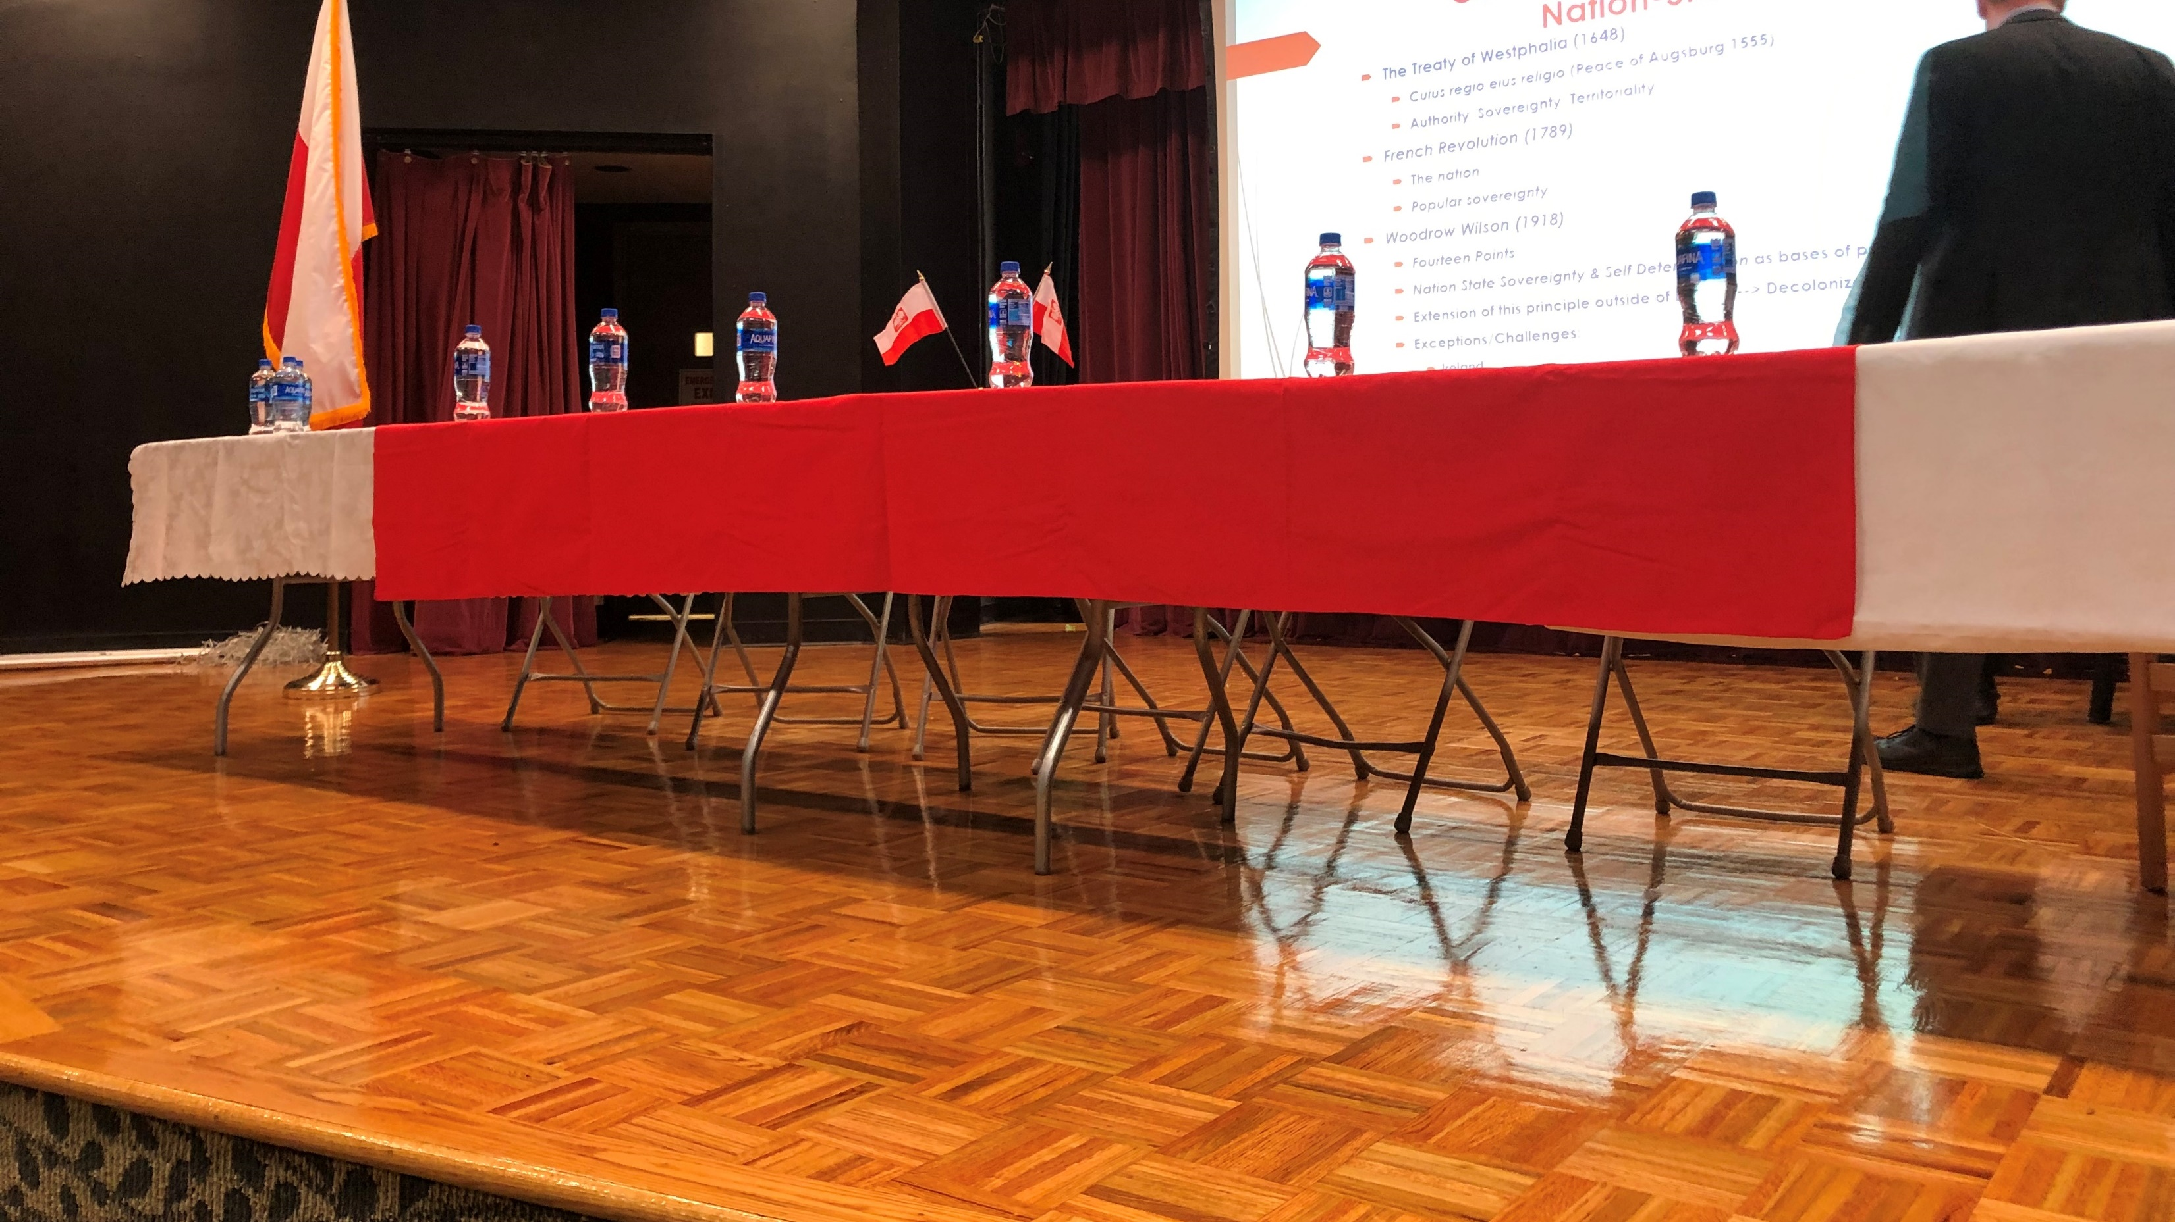
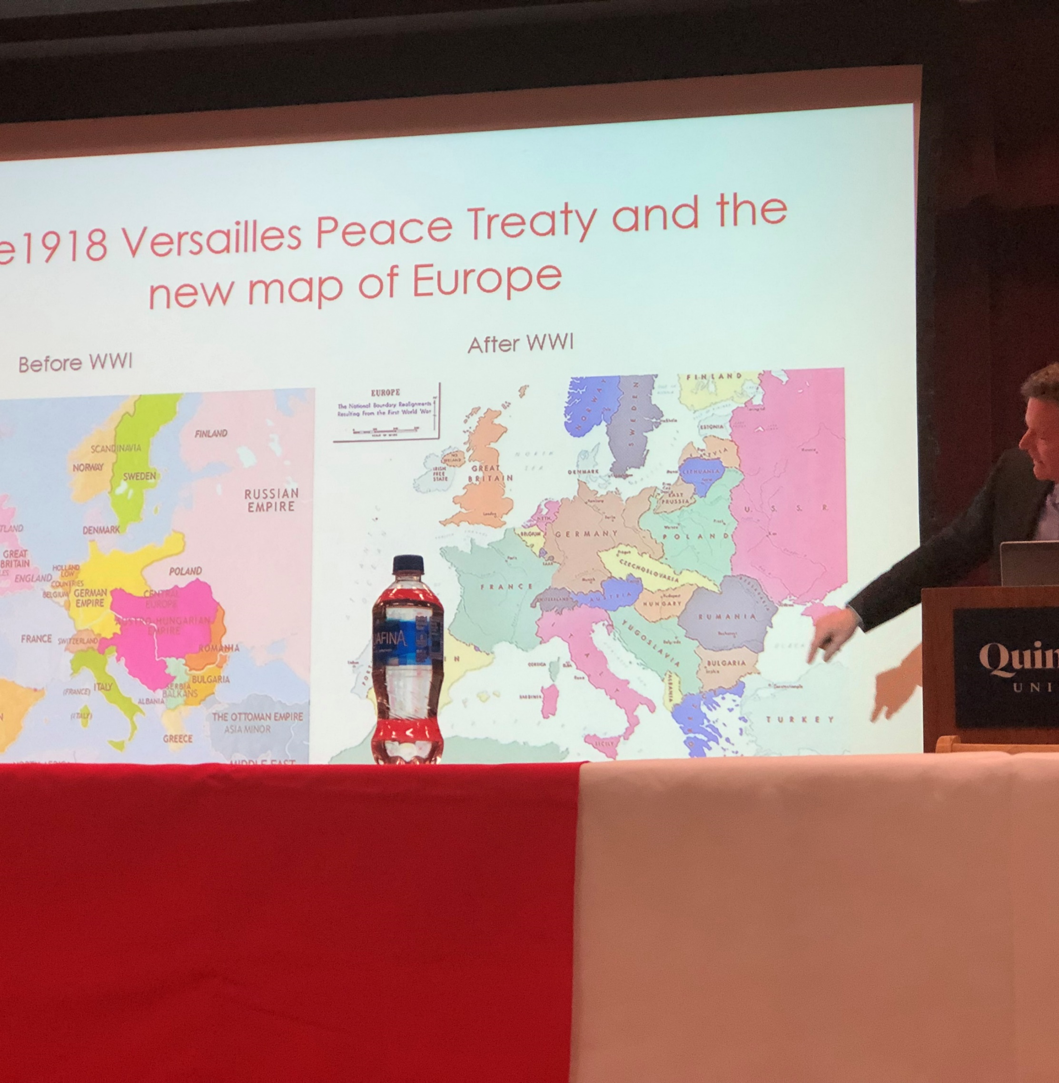
Prof. Monika Advocate led a panel discussion on Europe after the Treaty of Versailles, Polish cinematography, Polish outsourcing or Polish game industry November 13, 2018

Slide 6
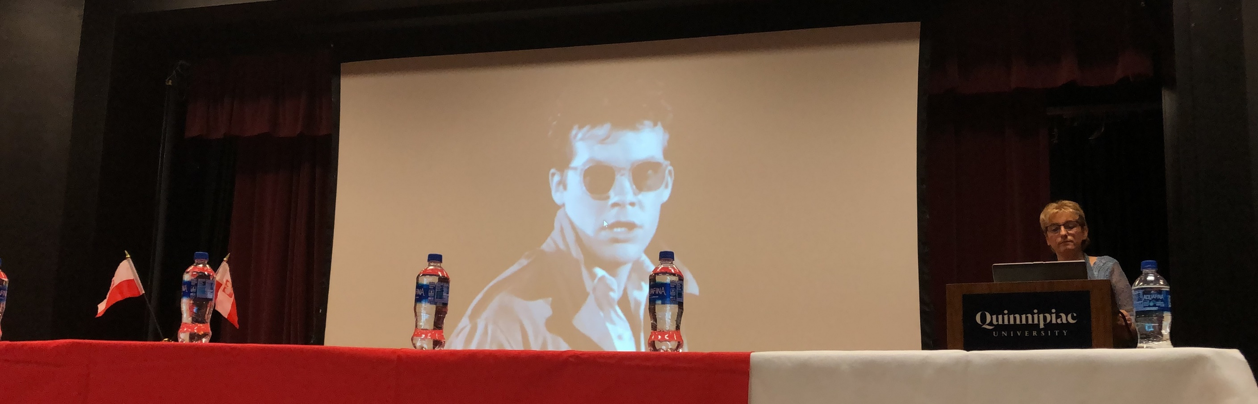
Prof. Ewa Callahan, Quinnipiac University made remarks about Polish cinamatography

Slide 7

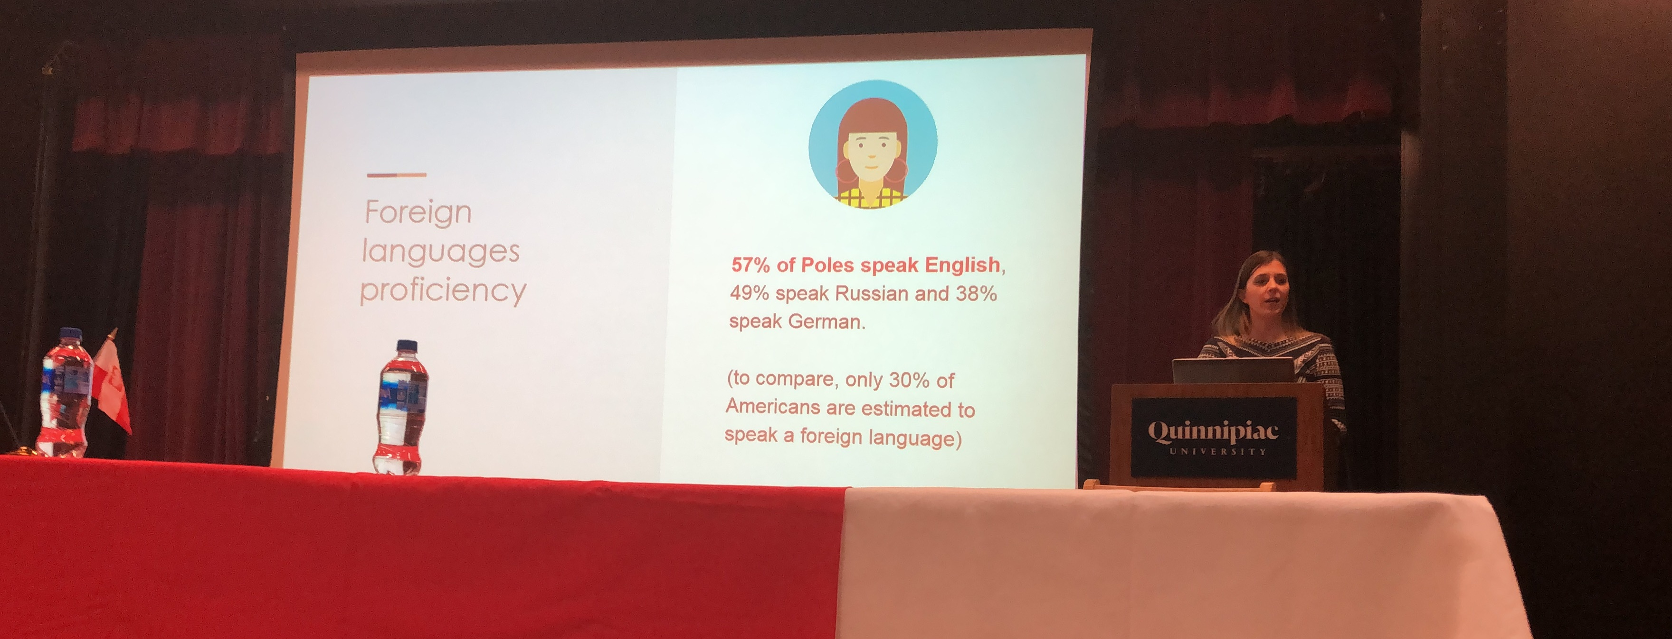
Milena Sadurska made a presentation about business opportunities - outsourcing in Poland

Slide 8
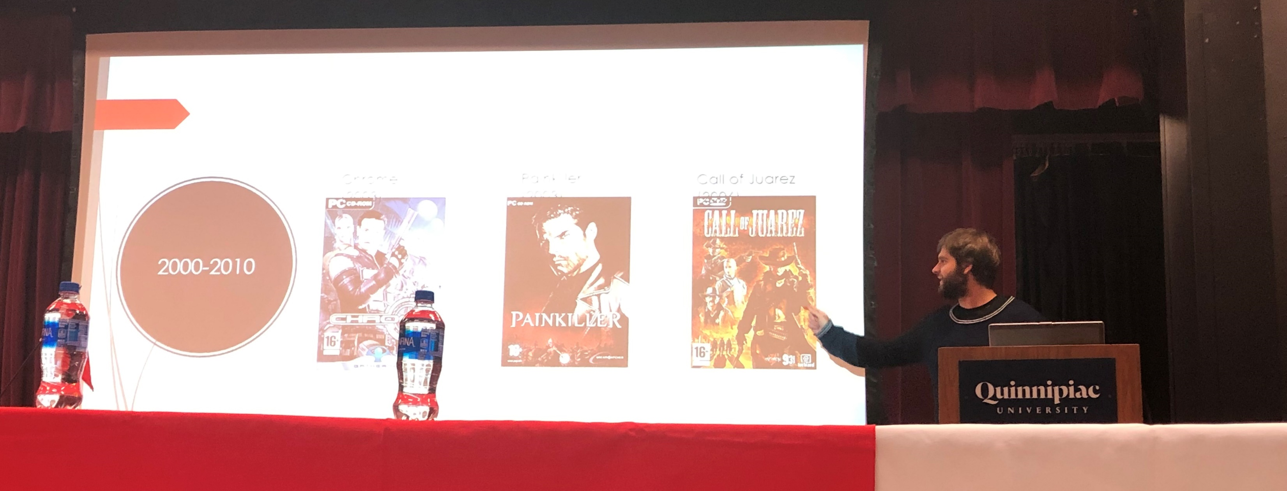
Wiktor Bednarek presented the Polish video game industry

Slide 9
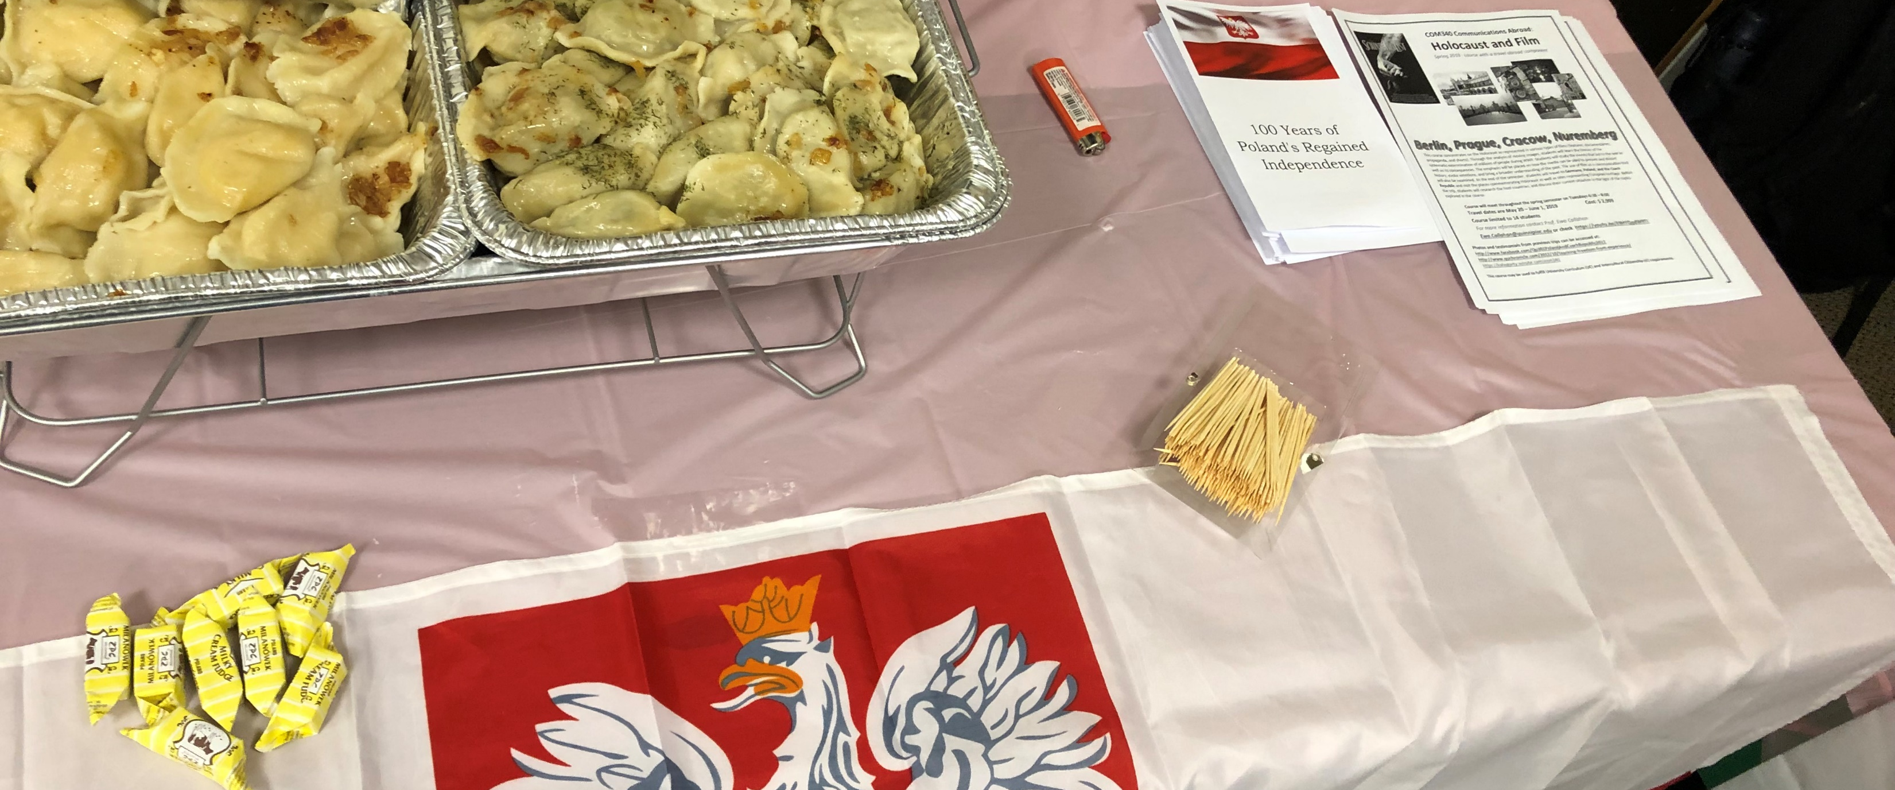
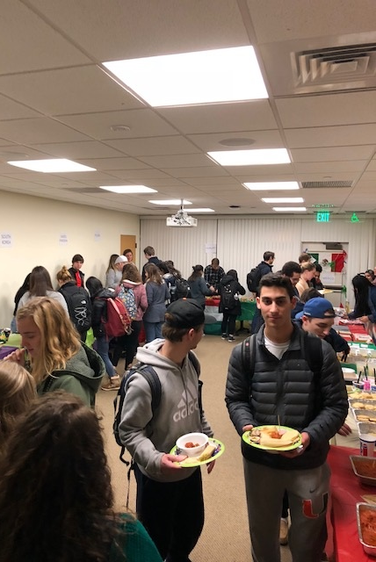
Culture night at Quinnipiac University
Students had the opportunity to taste the food from all over the World
November 14, 2018

Slide 10
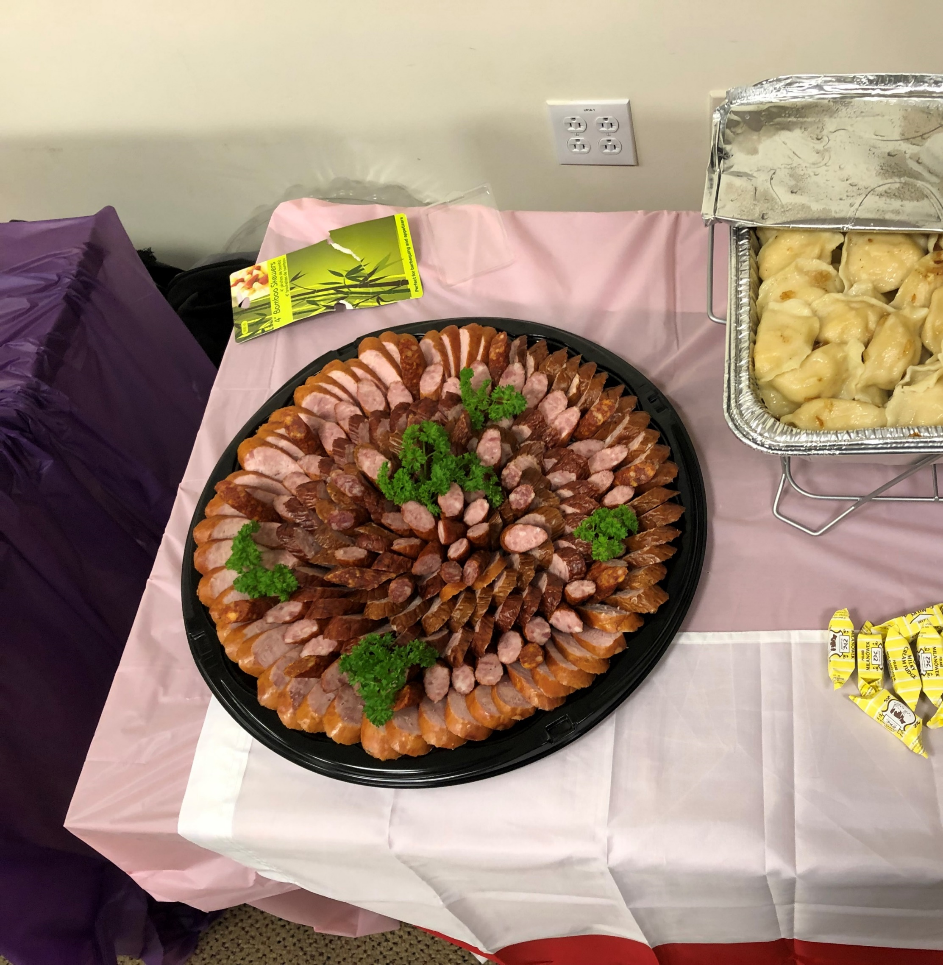
Polish „smakołyki” at the Polish table

Slide 11
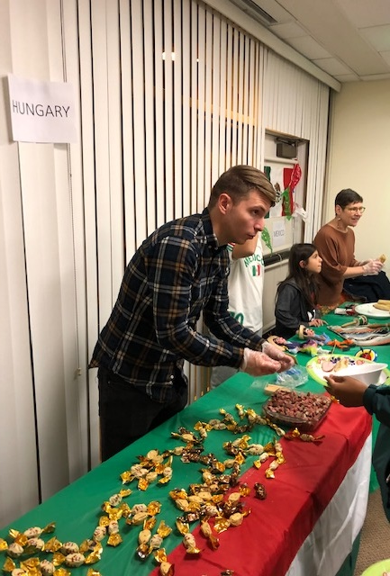
Bence Hausel, CEI’s student scholar from Hungary serving Hungarian salami

Slide 12
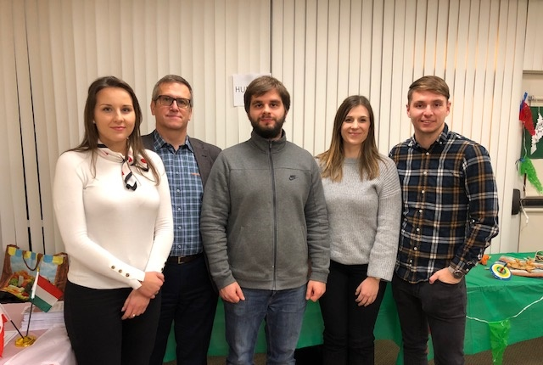
The „A” team of organizers
From left Aleksandra Wójcik, Gedeon Werner, Wiktor Bednarek, Milena Sadurska, Bence Hausel
Special thanks also go to Hanna Hejmowski, Bianca Strubbe and Marcell Molnár

Slide 13


Special „Thank you” to the Polish Cosulate in New York

